Slide 1
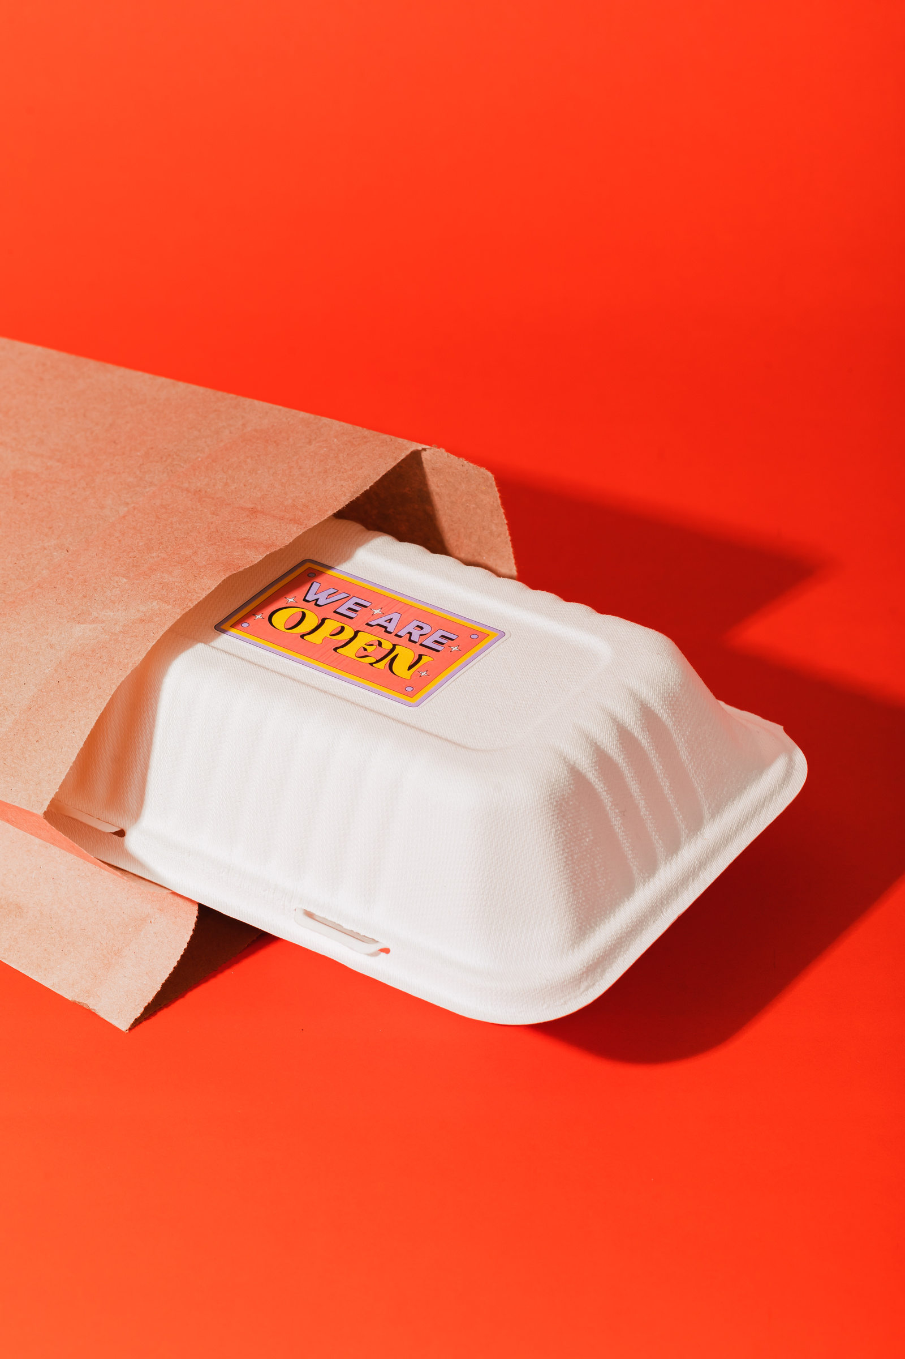


zomato
Home
About Us
Contact
Halo,
ZOMATO DINING ANALYSIS
THE FOOD DELIVERY SERVICE IN TOWN!
01

Slide 2
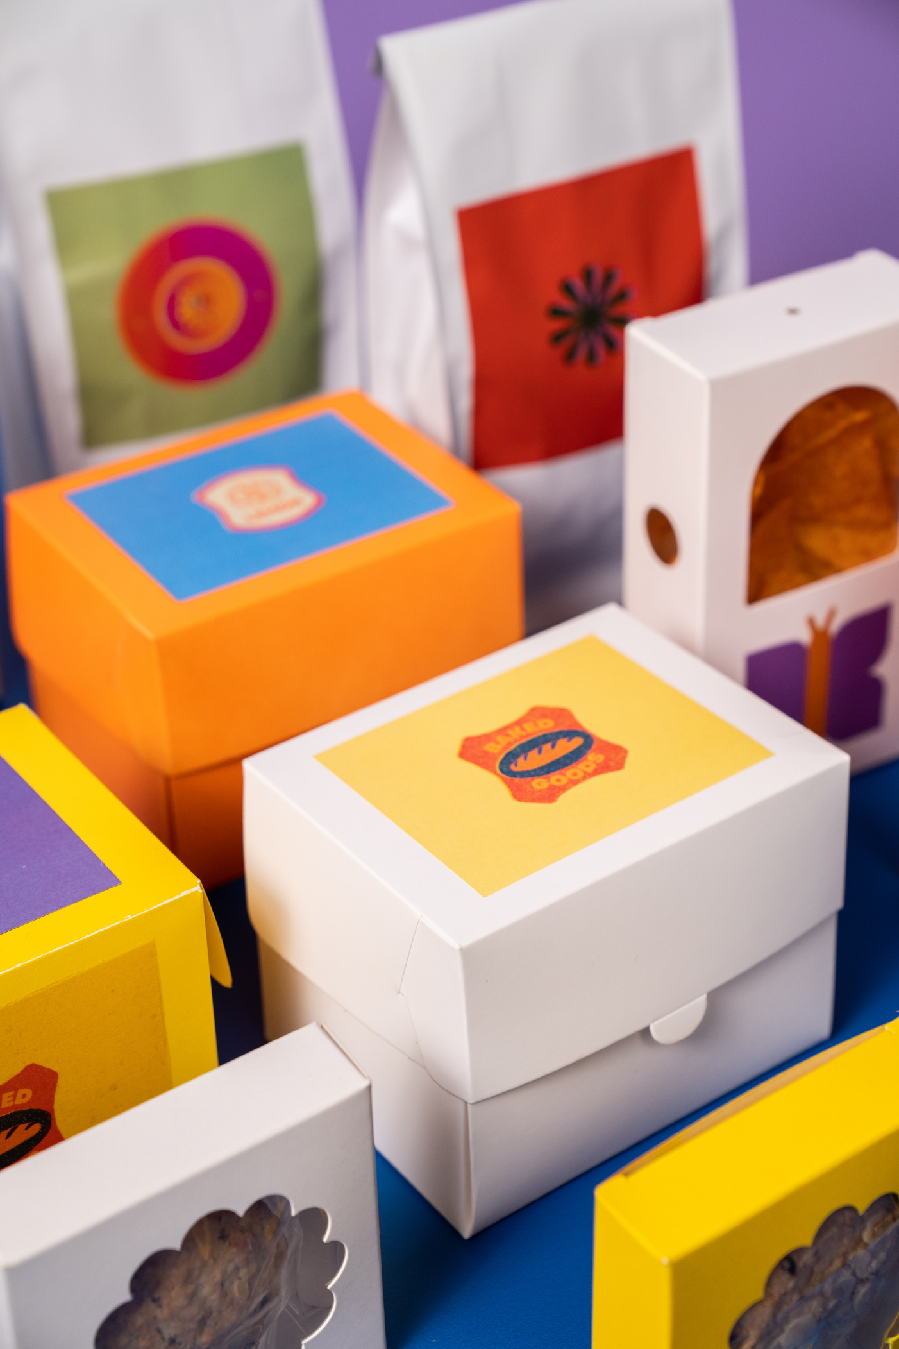

zomato
Home
About Us
Contact
Background
Zomato, founded in 2008, is a leading food-tech platform connecting users with restaurants through discovery, delivery, and reviews. Driven by its mission to “ensure nobody has a bad meal,” Zomato serves over 85 million users, processes 2.2 million+ orders daily, and partners with 300,000+ restaurants. With a ₹35,000+ crore order value and presence in 20+ countries, Zomato achieved its first quarterly profit in FY24 — a major milestone in its growth journey.
02

Slide 3


zomato
Home
About Us
Contact
Problem Statement
The challenge is to analyze the dataset trends,preferences,and areas of improvement that can enhance the overall user experience on the platform. Specifically the goal is to understand different factors such as location, price range, and ratings influence user choices and satisfaction
03

Slide 4
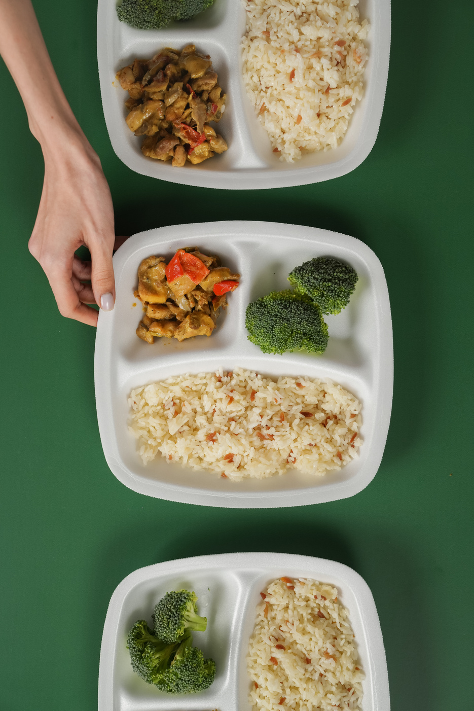

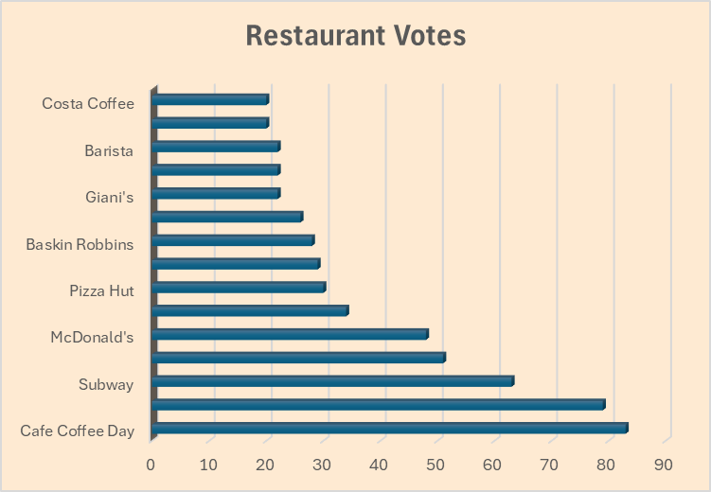
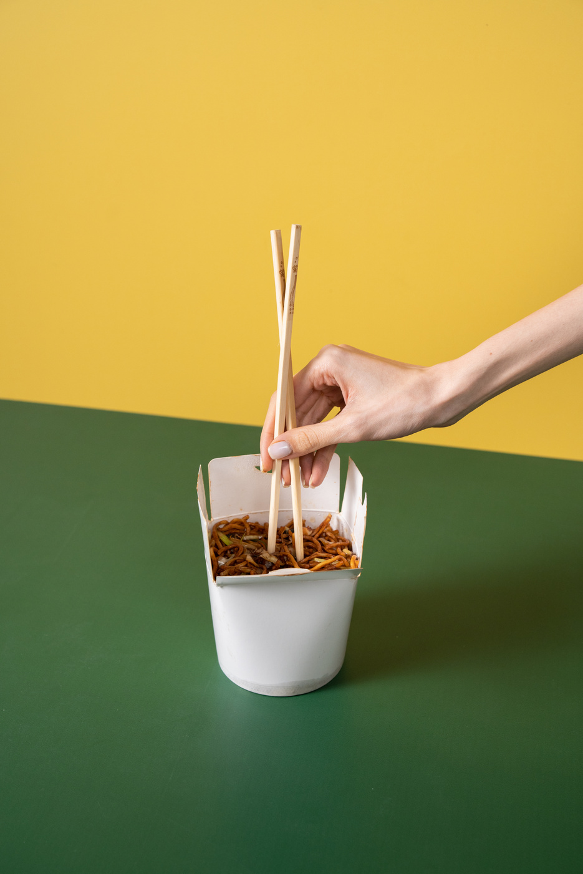
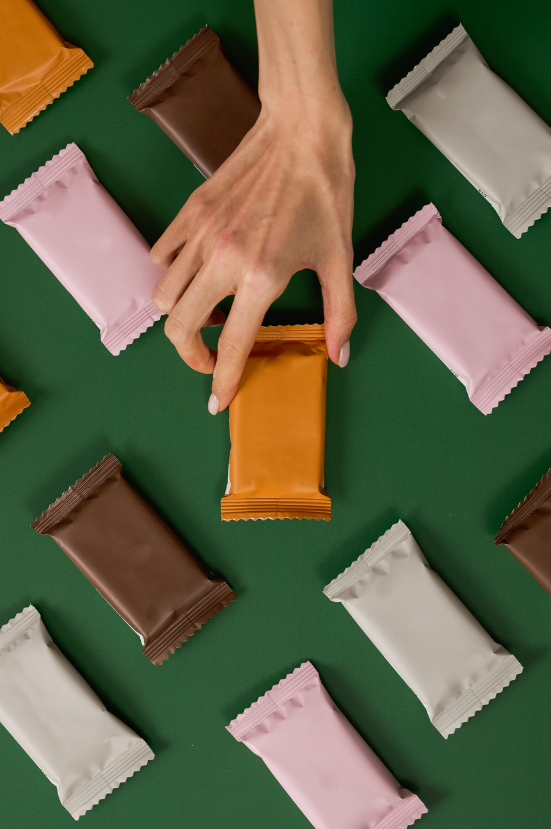

zomato
Home
About Us
Contact
Top restaurants according to votes
04

Slide 5
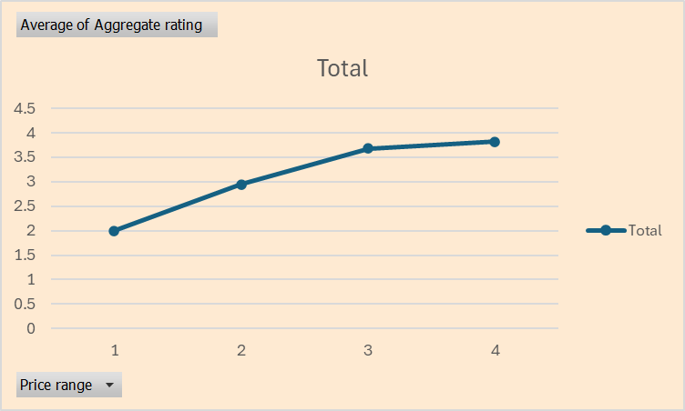
zomato
Home
About Us
Contact
Average rating across the price range of restaurants
05

Slide 6
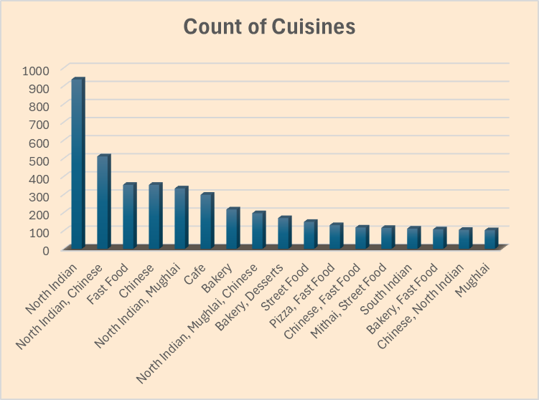
zomato
Home
About Us
Contact
Top Cuisines across the restaurants
06

Slide 7
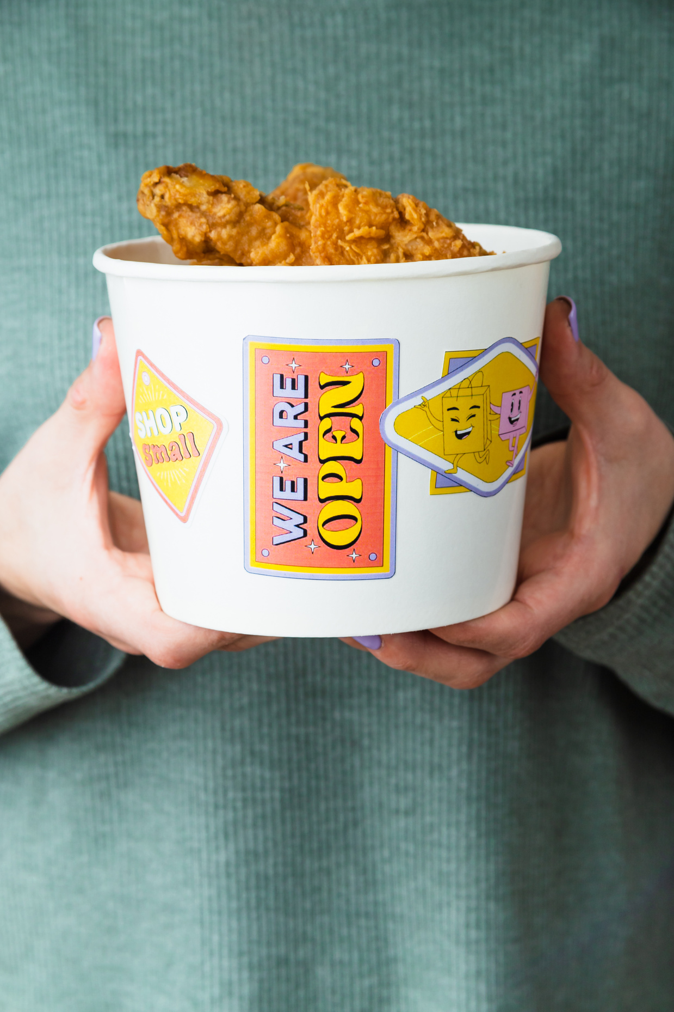
zomato
Home
About Us
Contact
KPI’s
Online Delivery: Only 2,451 out of 9,551 restaurants (~25.7%) offer online delivery, highlighting a 74.3% gap—an opportunity for expanding delivery services.
Cuisine Preference: North Indian cuisine dominates, offered by ~70% of restaurants, reflecting strong user preference.
Cost-Rating Correlation: Very weak negative correlation (-0.0518) between average cost for two and ratings—higher prices don’t impact satisfaction much.
Table Booking: Only 12% support table booking; 88% lack this feature. Promoting it could improve dine-in engagement.
Pricing Strategy: High average cost may deter budget-conscious users. Introducing tiered or budget options can broaden appeal.
Price Range vs Ratings: Restaurants in the highest price range (category 4) average 3.9 rating.
06

Slide 8
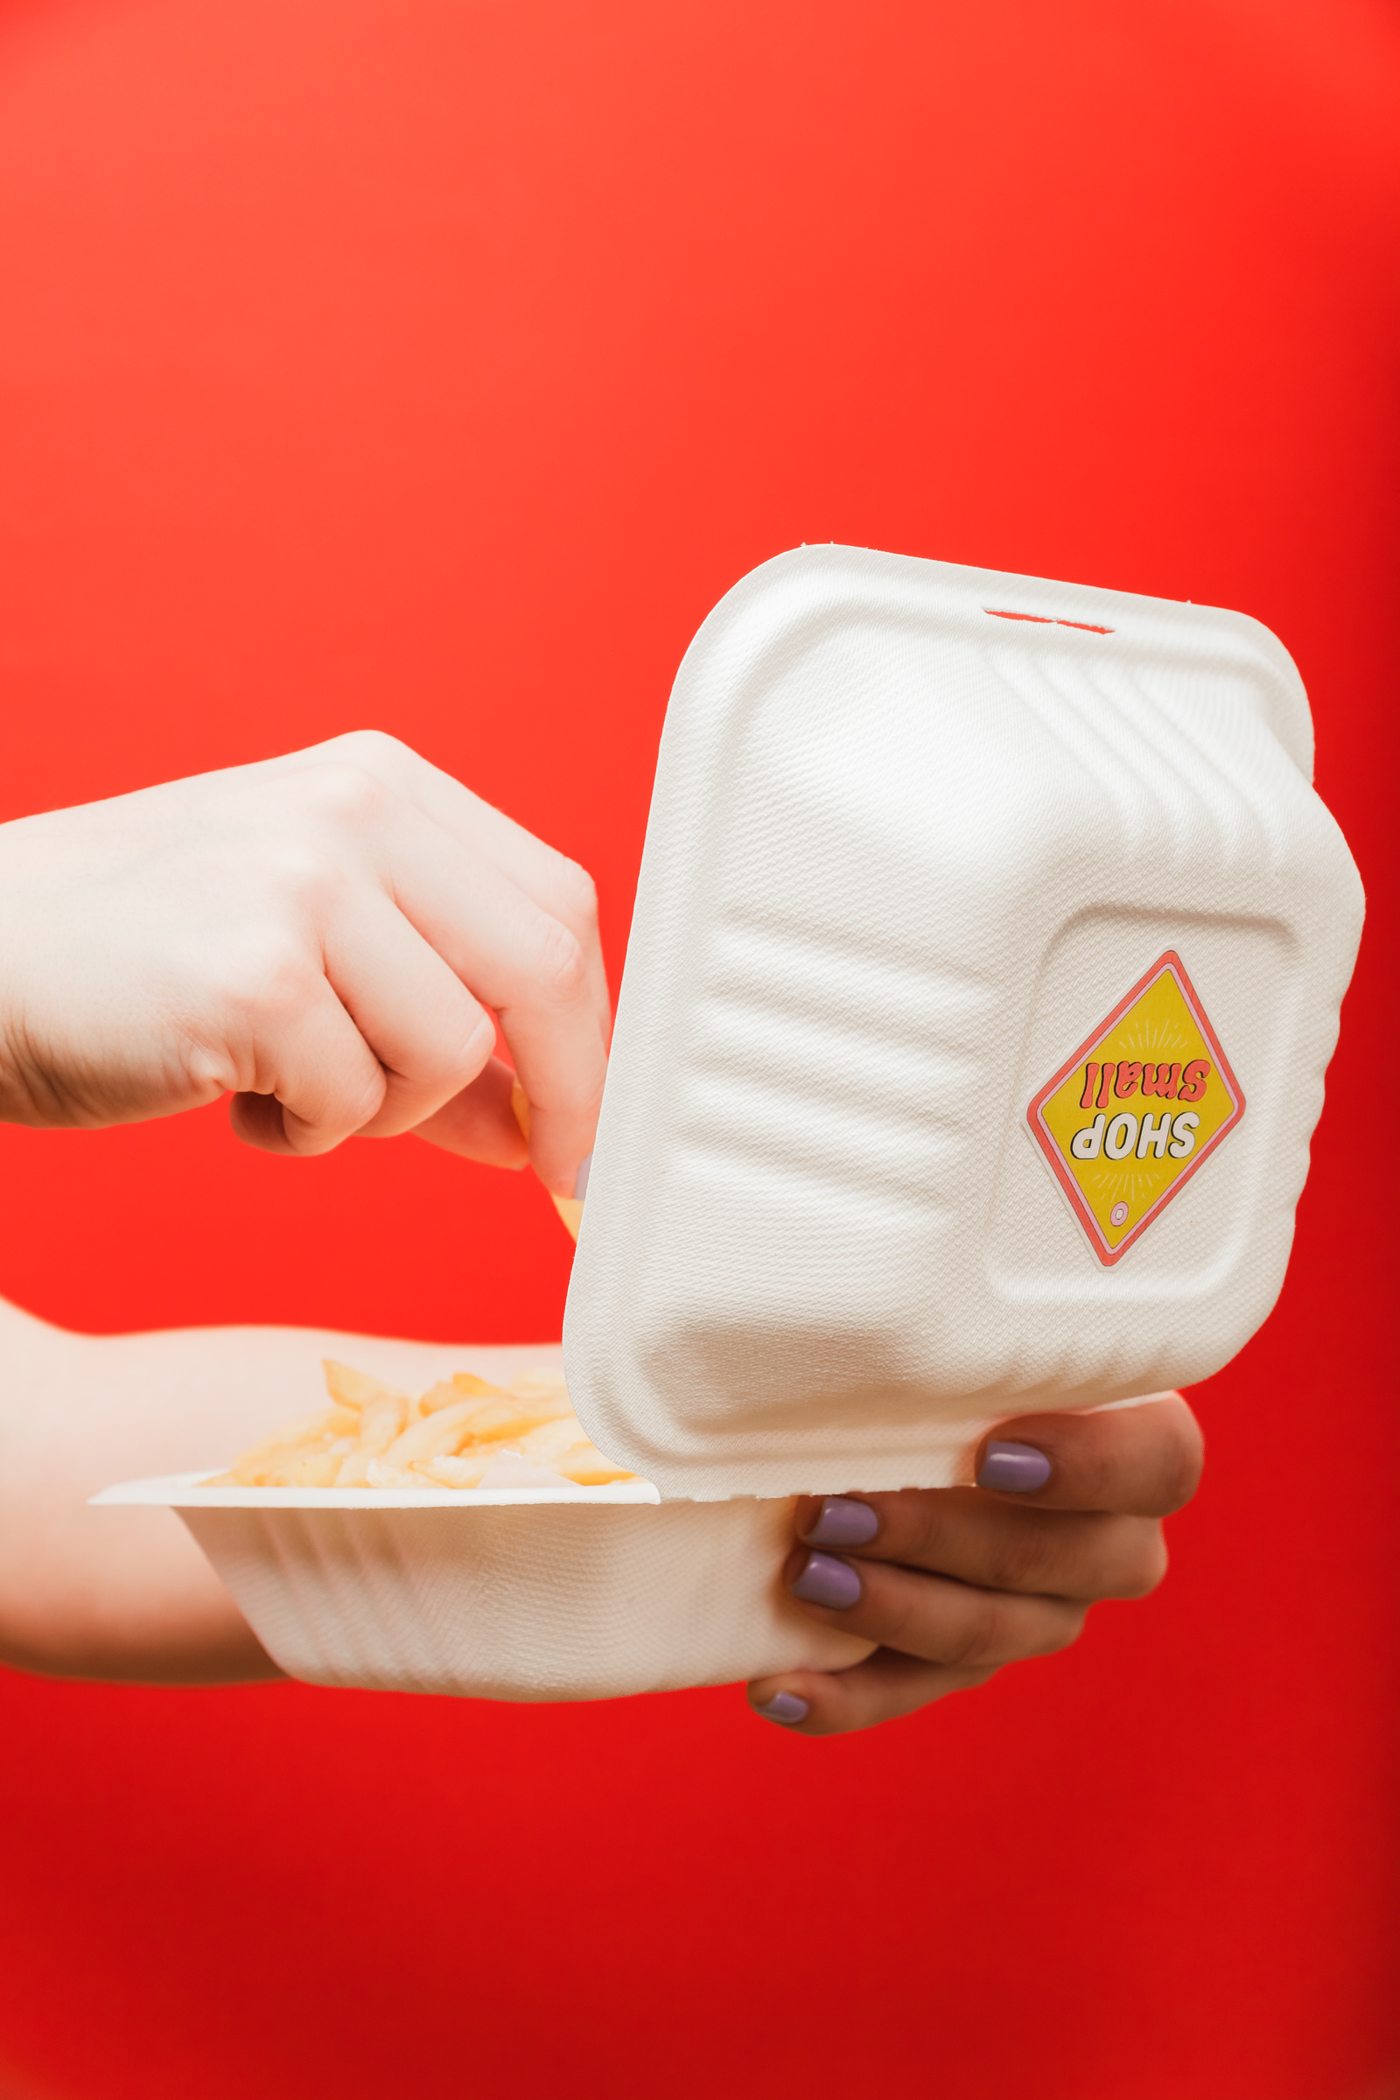


zomato
Home
About Us
Contact
Thank
You!
SHALINI PATIL
10

